Slide 1

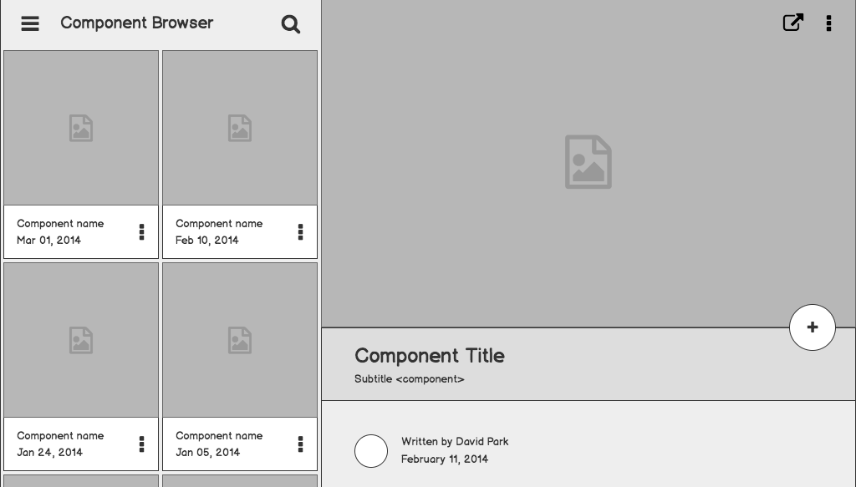

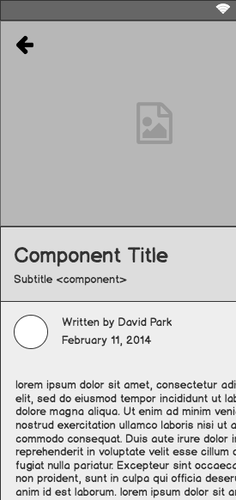
Should Tennis be Played?
A supervised machine learning decision tree based on historical data.

Slide 2
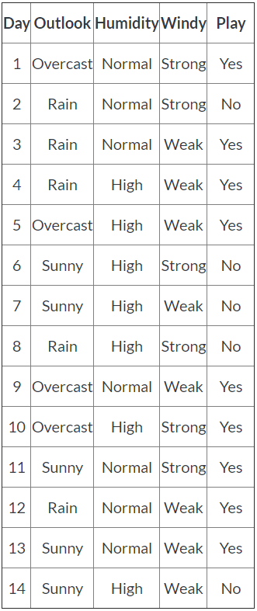
Supporting Information
1
To create this decision tree, we will use historical data based on three weather criteria do decide if we should go out and play tennis.
(CSU Global,n.d.)

Slide 3
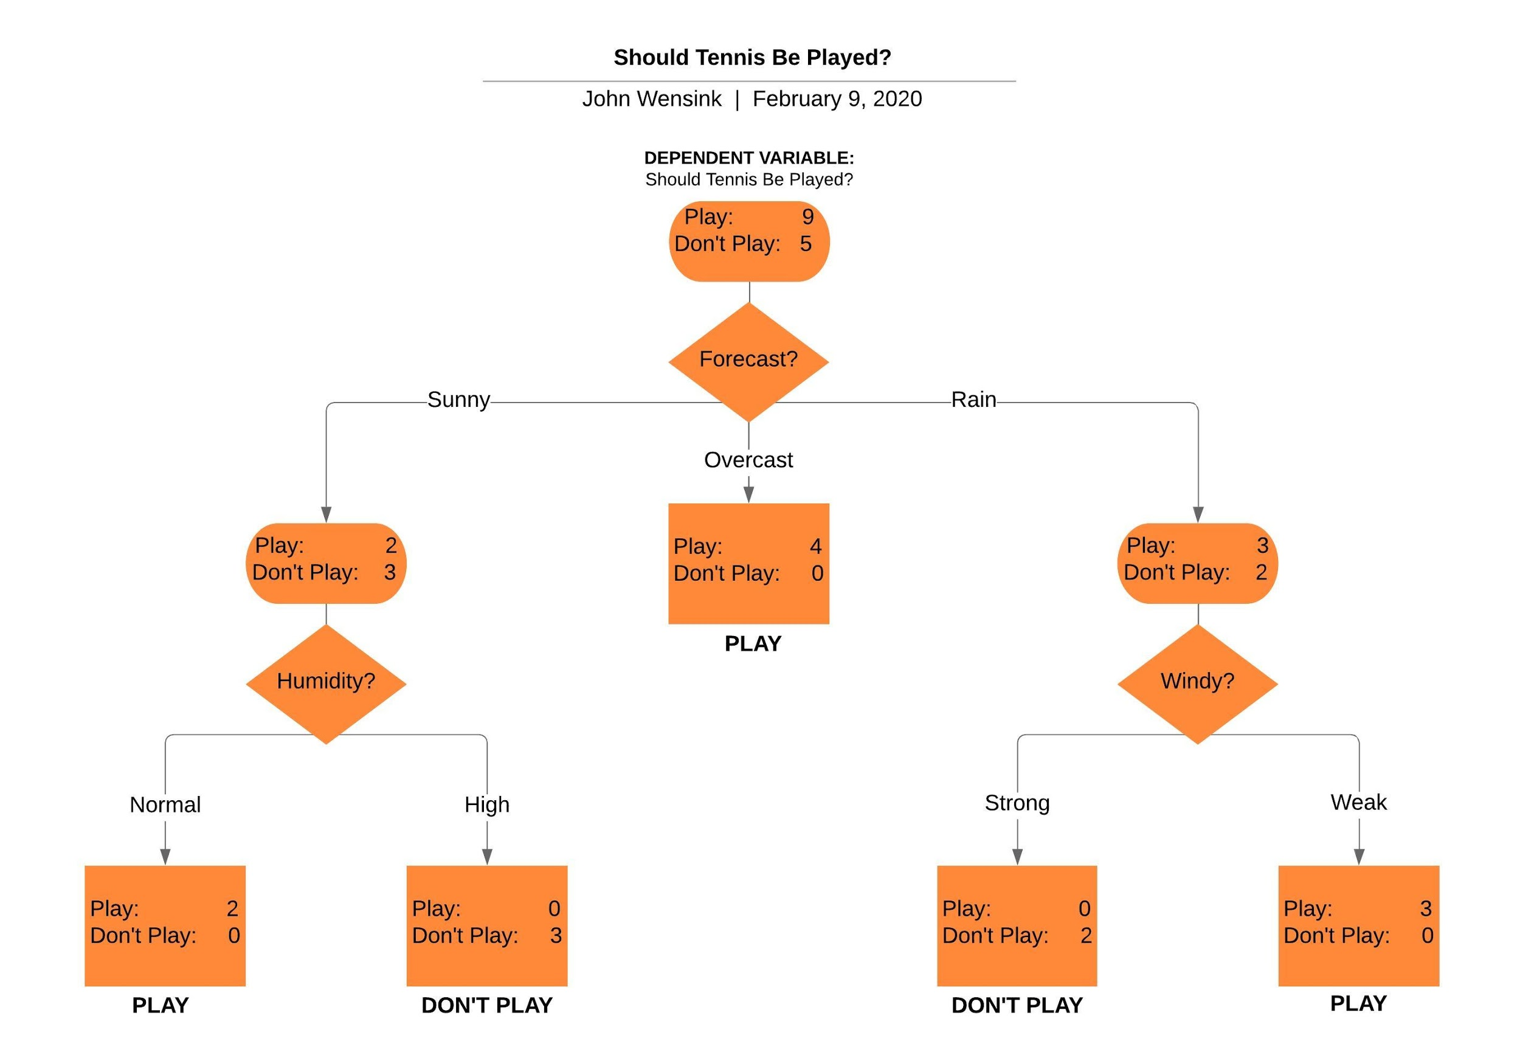
Decision Tree
A simple decision tree can help us decide if today’s weather is conducive to going out to play tennis.

Slide 4
Why Use a Decision tree?
Supervised machine learning makes sense when we have reliable training data available to help us make predictions regarding a decision that will be made in the future, based on the same set of variables (Hwang & Chen, 2017, p. 172).
In this example, the attributes in the lookup table are discrete, meaning that the variables either do, or do not belong to a certain attribute class (CSU Global, n.d.). If we were going to make a decision tree with a continuous variable such as humidity, a distinction must be made as to what values an attribute can have to make it belong to a particular group (i.e. humidity is <= 70%, or >70%).
The data in this lookup table makes it easy to come to a decision on whether tennis will be played or not, as the leaf nodes reflect probabilities of 100% or 0% chance of tennis being played based on the leaf’s input variables. However, real life data is rarely this black and white. Rather, a series of probabilities are likely to emerge from the data. In the case of whether tennis should be played, play probabilities >50% at the leaf level would indicate a decision to play.
When constructing a decision tree based on the ID3 algorithm, one should be mindful of the entropy of the dataset, so that the model is “recursively partitioned into smaller subsets” (Hwang & Chen, 2017, p. 173). This means that the dataset’s purity or efficvivity has a logarithmic relationship with size of the sample dataset. From this observation, we can see that data closer to the root of the tree has a higher effective information gain than data closer to the leaf (Shubham, n.d.).

Slide 5
References
CSU Global. (n.d.). Supervised Machine Learning. Retrieved February 9, 2020, from https://csuglobal.instructure.com/courses/17310/modules/items/844395
Hwang, K., & Chen, M. (2017). Big-data analytics for Cloud, IoT and cognitive computing. Chichester, West Sussex: Wiley Blackwell.
Shubham. (n.d.). Decision Tree Tutorials & Notes: Machine Learning. Retrieved February 9, 2020, from https://www.hackerearth.com/practice/machine-learning/machine-learning-algorithms/ml-decision-tree/tutorial/

